Slide 1
HNDIT 1104: Data Representation and Organization

Slide 2
Module Code | HNDIT1104 | Module Title | Data Representation & Organization
Credits | 2 | Hours /Week | Lectures | 15
GPA/NGPA | GPA |  | Lab/Tutorial | 30
Semester | 1 | Module Type | Common Core
Aim of the Module
To enable the students to understand and describe how information and data are represented inside a computer system

Slide 3
Assessment and Weighting
Type | Activity | Weighting
Continuous Assessment | In-class discussions, group work, Quizzes, Assignments and tutorials | 50%
End of semester examination | Structured exam paper | 50%

Slide 4
Learning Outcomes
At the end of the module the student will be able to: Describe the terms data, information, Weighted and non-weighted number systems Describe and use different number formats and convert data between different number formats Describe and use appropriate coding schemes for data representation Describe and determine the precision and range associated with different numerical representation Select appropriate coding and data representation scheme for a given application considering their advantages, disadvantages and limitations

Slide 5
Data types and Data representation
HNDIT1104: Data Representation and Organization
Lesson 1

Slide 6
Learning Objectives
At the end of the lesson students should be able to
Describe difference between data and information
Describe how computer organized the data
Explain term bit, byte, word and different data types
Identified the weighted and non weighted number system
Explain weighted number system
Identify different number systems
Define base, number of digits and digits of that number systems

Slide 7
What is a computer ?
A computer is an electronic device, operating under the control of instructions stored in its own memory
Collects data (input)
Produces information (output)
Processing
Information Processing Cycle

Slide 8
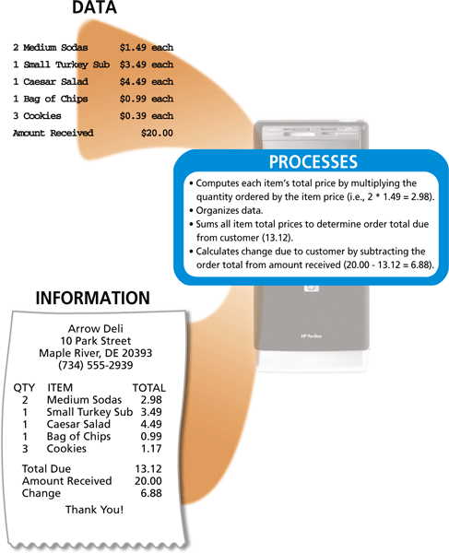

Slide 9
Data and Information
Data :
collected row facts
Cannot be used for decision making
Ex: Student Name, Exam marks, exam status
Information:
Processed data
Can be used to decision making
Ex: - Students name in alphabetical order.
- Students who have passed the exam.

Slide 10
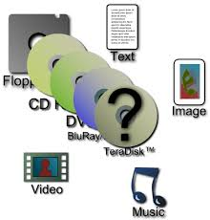
Data in Computing System
Usually the computing systems are complex devices, dealing with a vast array of information categories
The computing systems store, present, and help us modify:
Text
Audio
Images and graphics
Video

Slide 11
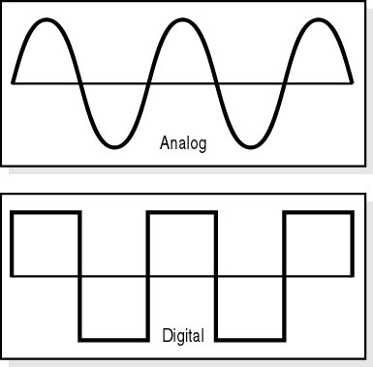
Ways of representing Data/Information
The data/information can be represented in one or two ways:
Analog
or
Digital

Slide 12
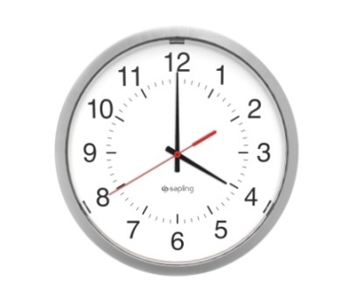
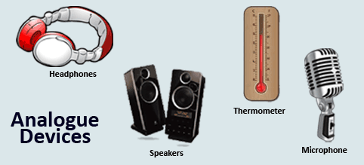
Analog data vs. Digital data
Analog data is a continuous representation, analogous to the actual information it represents. Analog data uses values that changes very smoothly.
Ex. A good example of this is an analogue clock.
An analogue clock shows the time with a smoothly
moving seconds hand. The change is continuous.
All analogue devices use analogue data. Examples of analogue devices
include:
Microphone
Headphones
Loud Speaker
Sensors (temperature, pressure etc.)

Slide 13
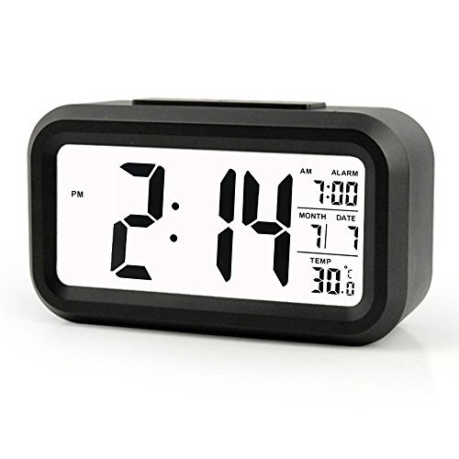
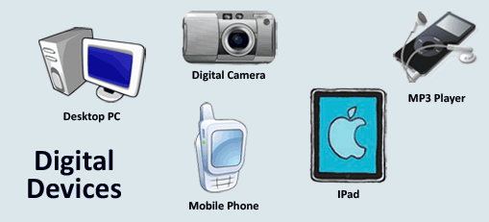
Analog data vs. Digital data
Digital data is a discrete representation, breaking the information up into separate (discrete) elements . Digital data jumps from one value to the next in a step by step sequence
Ex. A good example of this is a digital clock.
A digital clock jumps from one second to another in clear steps.
The change is not smooth or continuous.
All digital devices use digital data. Examples of digital devices include:
Computers/Laptops/IPads
Mobile Phone
MP3 Player
Digital Camera

Slide 14
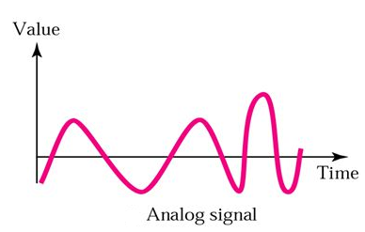
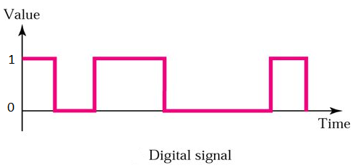
Analog and Digital Signal
There are two types of signals that carry data - analog and digital
signals.
Analog data can be represented
using analog signal. An Analog signal
is a continues wave form that changes
smoothly over time.
Digital data can be represented
using digital signal. Digital signal is
stepping, square, and discrete.

Slide 15
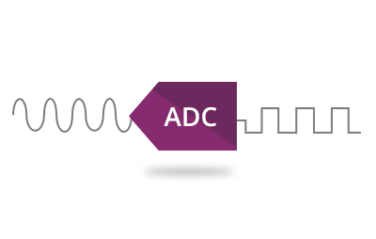
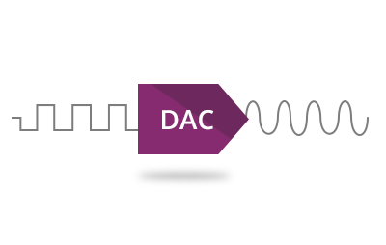
Analog and digital conversion
Analogue values can only be used by analogue devices.
Digital values can only be used by digital devices.
If we want to use analog values with a digital device or
digital values with an analog device we need to use data
conversion.
There are two types of data converters:
1. Analog to Digital Converter (ADC) 2. Digital to Analog Converter (DAC)

Slide 16
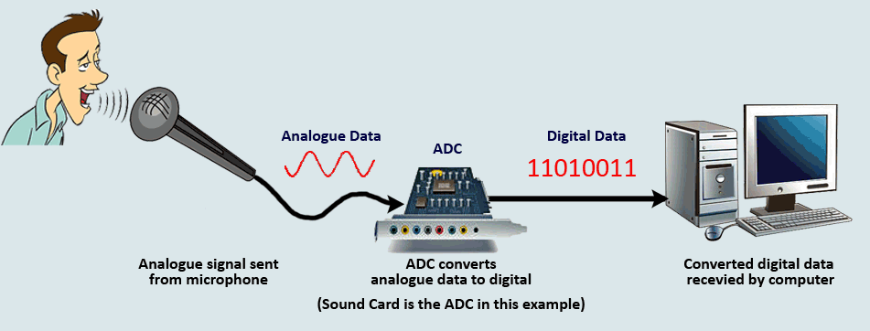
1. Analog to Digital Converter (ADC)
If we try to attach an analogue device (like a microphone) to a computer we will need to convert the analog data to digital before the computer can use it.

Slide 17
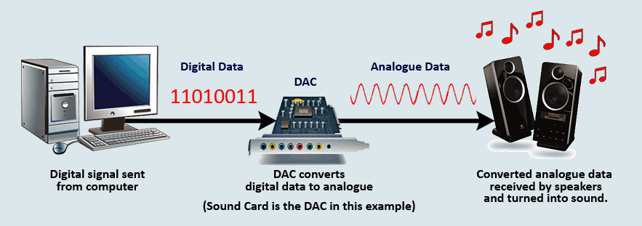
2. Digital to analog Converter (DAC)
If we want to listen to digital music (like mp3's) we would need to attach an analog device such as loud speakers or headphones to our computer

Slide 18
Represent Data in Computer
Early computer design was decimal
Mark I and ENIAC
John von Neumann proposed binary data processing (1945)
Simplified computer design
Computers are digital. Recognize only two discrete states: ‘on’ or ‘off’
Used for both instructions and data
Natural relationship between on/off switches and calculation using Boolean logic
On | Off
True | False
Yes | No
1 | 0

Slide 19

How do computers represent data?
Convert analog signals to digital signals after capturing them by the input devices
Digital signals are represented by numbers [ The name "Digital" is given to all devices that store and process data in the form of 'digits' (numbers)].
ALL data must be represented in memory as binary digits (bits)
1 1 1 1 1
0 0 0 0 0

Slide 20
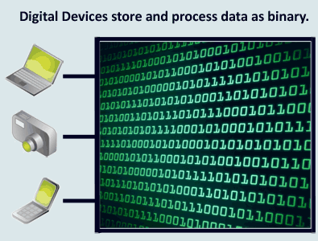
What is Binary ?
All computer data is really a number known as a Binary Digit (often shortened to just binary)
Binary is represented by the numbers 1 and 0.
Different combinations of these 1's and 0's are used to represent all the different kinds of data that can be stored and processed within a digital device (such as a computer).
For example:- The word 'Hello' is stored as the binary combination of
0100100001100101011011000110110001101111

Slide 21
Basic Data Types Available in Computer
Numeric Data
Numbers (Integer, real)
Non-numeric Data
Letters, Symbols
Alphanumeric ( consisting of both letters and numbers and often other symbols)
Image data
Audio data
Video data

Slide 22
Data Units use in a Computer
A bit is the most basic unit of information in a computer.
It is a state of “on” or “off” in a digital circuit.
Sometimes they represent high or low voltage
A byte is a group of eight bits.. It is the smallest possible addressable unit of computer storage.

Slide 23
2.1 Introduction
A word is a contiguous group of bytes.
Words can be any number of bits or bytes.
Word sizes of 16, 32, or 64 bits are most common.
A group of four bits is called a nibble.
Bytes, therefore, consist of two nibbles: a “high-order nibble,” and a “low-order” nibble

Slide 24
Bit: It is the smallest unit of information used in a computer system. It can either have the value 0 or 1. Derived from the words binary digit.
Nibble: It is a combination of 4 bits.
Byte: It is a combination of 8 bits.
Word: It is a combination of 16 bits.
Double word: It is a combination of 32 bits.
Kilobyte (KB): It is used to represent the 1024 bytes of information.
Megabyte (MB): It is used to represent the 1024 KBs of information.
Gigabyte (GB): It is used to represent the 1024 MBs of information.

Slide 25
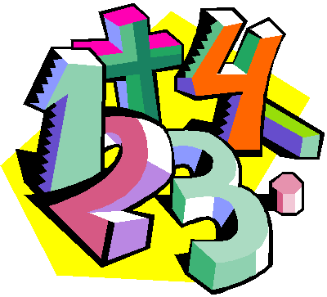
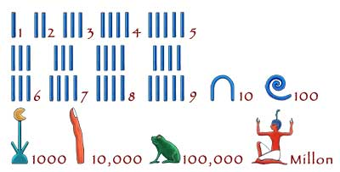
Number systems
Positional Number System / Weighted Number System
Non positional number system / non Weighted Number System

Slide 26
The Non-weighted/ Non Positional Numbers
The non-weighted numbers are not positional weighted .
That are not assigned with any weight to each digit position.
position independent
Ex-
Roman number system
Roman numerals symbols with different values: I (1), V (5), X (10), C (50), M (100)
Examples: I, II, III, IV, VI, VI, VII, VIII, IX
Egyptian number system

Slide 27
Weighted Numbers/ Positional Number
The weighted numbers are those that obey the position weighting principle
which states that the position of each number represent a specific weight.
Numeric values are represented by a sequence of digit symbols. Each digit position has a value called a weight associated with it
Ex:
decimal numbers
Binary numbers
Octal numbers
Hexadecimal numbers

Slide 28
Decimal (base 10): weights in powers-of-10.
Binary digits (bits): 0,1,2,3,4,5,6,7,8,9
Binary (base 2): weights in powers-of-2.
Binary digits (bits): 0,1.
Octal (base 8): weights in powers-of-8.
Octal digits: 0,1,2,3,4,5,6,7.
Hexadecimal (base 16): weights in powers-of-16.
Hexadecimal digits: 0,1,2,3,4,5,6,7,8,9,A,B,C,D,E,F.
Base R: weights in powers-of-R.

Slide 29
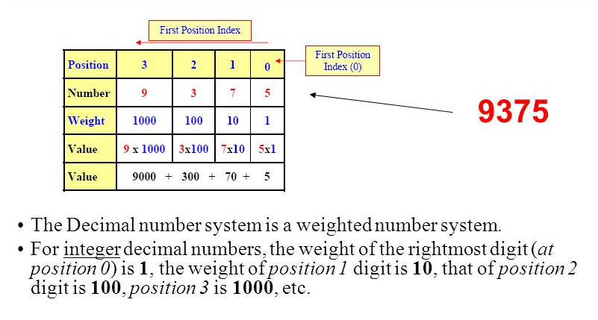
Example:

Slide 30
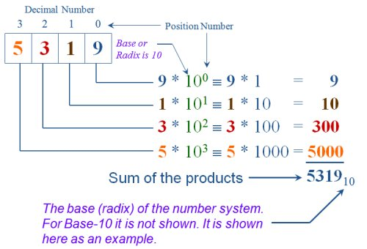

Slide 31
Positional number system
Base (or radix) R number
Uses R distinct symbols for each digit
Example A _{R} = a _{n-1} a _{n-2} ... a ₁ a ₀ .a ₋₁ …a _{–m}
V(A _{R}) = SUM (a _{k} * R ^{k}) for k = -m to n-1
R = 10 Decimal number system
R = 2 Binary
R = 8 Octal
R = 16 Hexadecimal

Slide 32
Polynomial Evaluation
Whole Numbers (Radix = 10):
1234₁₀ = 1 × 10³ + 2 × 10² + 3 × 10¹ + 4 × 10⁰
With Fractional Part (Radix = 10):
36.72₁₀ = 3 × 10¹ + 6 × 10⁰ + 7 × 10⁻¹ + 2 × 10⁻²
General Case (Radix = R):
(S₁S₀.S₋₁S₋₂)_{R} =
S₁ × R¹ + S₀ × R⁰ + S₋₁ × R ⁻¹ + S₋₂ × R⁻²

Slide 33
Examples:
a) N = 278
r = 10 (base 10) => decimal numbers
symbol: 0, 1, 2, 3, 4, 5, 6, 7, 8, 9 (10 different symbols)
N = 278 => n = 2;
a₂ = 2; a₁ = 7; a₀ = 8
278 = (2 x 10²) + (7 x 10¹) + (8 x 10⁰)
N = a_{n}r^{n} + a_{n-1}r^{n-1} + … + a₁r¹ + a₀r⁰
Hundreds
Tens
Ones

Slide 34
b) N = 1001₂
r = 2 (base-2) => binary numbers
symbol: 0, 1 (2 different symbols)
N = 1001₂ => n = 3;
a₃ = 1; a₂ = 0; a₁ = 0; a₀ = 1
1001₂ = (1 x 2³)+(0 x 2²)+(0 x 2¹)+(1 x 2⁰)
c) N = 263₈
r = 8 (base-8) => Octal numbers
symbol : 0, 1, 2, 3, 4, 5, 6, 7,
(8 different symbols)
N = 263₈ => n = 2; a₂ = 2; a₁ = 6; a₀ = 3
263₈ = (2 x 8²) + (6 x 8¹) + (3 x 8⁰)

Slide 35
d) N = 263₁₆
r = 16 (base-16) => Hexadecimal numbers
symbol : 0, 1, 2, 3, 4, 5, 6, 7, 8, 9, A, B, C, D, E, F
(16 different symbols)
N = 263₁₆ => n = 2;
a₂ = 2; a₁ = 6; a₀ = 3
263₁₆ = (2 x 16²)+(6 x 16¹)+(3 x 16⁰)

Slide 36
Examples:
(1101.101)₂
(572.6)₈
(2A.8)₁₆
(341.24)₅

Slide 37
Conversation to the decimal
1. (1101.101)₂
= 1×2³ + 1×2² + 1×2⁰ + 1×2⁻¹ + 1×2⁻³
= 8 + 4 + 1 + 0.5 + 0.125 = (13.625)₁₀
2. (572.6)₈
= 5×8² + 7×8¹ + 2×8⁰ + 6×8⁻¹
= 320 + 56 + 2 + 0.75 = (378.75)₁₀
3. (2A.8)₁₆
= 2×16¹ + 10×16⁰ + 8×16⁻¹ = 32 + 10 + 0.5 = (42.5)₁₀
4. (341.24)₅
= 3×5² + 4×5¹ + 1×5⁰ + 2×5⁻¹ + 4×5⁻²
= 75 + 20 + 1 + 0.4 + 0.16 = (96.56)₁₀

Slide 38
Examples
953.78
1011.11₂
3. A2F ₁₆

Slide 39
1) 953.78 = 9 x 10² + 5 x 10¹ + 3 x 10⁰ + 7 x 10⁻¹ + 8 x 10⁻² = 900 + 50 + 3 + .7 + .08 = 953.78
2) 1011.11₂ = 1x2³ + 0x2² + 1x2¹ + 1x2⁰ + 1x2⁻¹ + 1x2⁻² = 8 + 0 + 2 + 1 + 0.5 + 0.25 = 11.75
3) A2F ₁₆ = 10x16² + 2x16¹ + 15x16⁰ = 10 x 256 + 2 x 16 + 15 x 1 = 2560 + 32 + 15 = 2607

